Slide 1
Distributed Coordination Based Systems

Slide 2
Distributed Coordination Based Systems
Newer generation technology
Assumes that components are distributed and that coordination of the activities is the problem

Slide 3
Key Concepts
Separation between computation and coordination
Coordination handles all communication and cooperation between processes
Classified by temporal and referential coupling

Slide 4
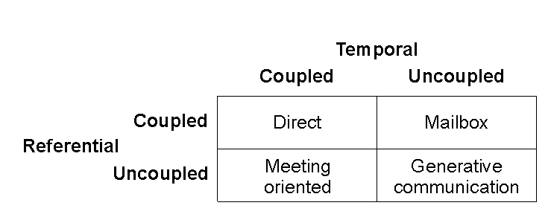
Taxonomy of Coordination Models

Slide 5
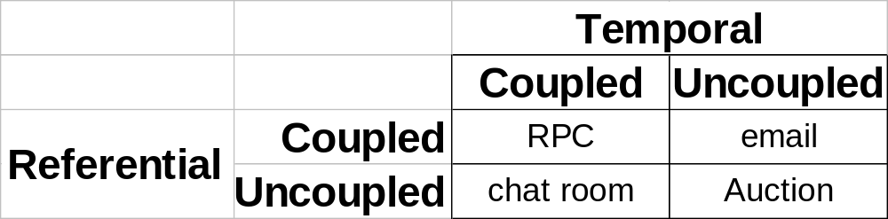
Taxonomy of Coordination Models Examples

Slide 6
Taxonomy of Coordination Models
Direct – Traditional message passing, both processes active
Mailbox – used as a temporary store if receive process in not active
Meeting oriented – messages exchanges by active participants via an intermedatory
Generative – general exchange of tuples

Slide 7
Example Systems
TIB/Rendezvous (TIBCO)
Jini/JavaSpaces (Sun Microsystems)

Slide 8
TIB/Rendezvous
Based on the Rendezvous information bus
Application independent
  no specialised protocols
  applications have to get involved (see sidebar)
Messages are self-describing
Referentially uncoupled

Slide 9
Sidebar
From a communications architectural perspective it is convenient to hide functionality in layers – to simplify apps.
Applications however often have the knowledge to implement a special feature
e.g. causal messages delivery, can be more efficiently implemented at the application layer

Slide 10
TIB/Rendezvous
Coordination Model
Meeting Oriented
  referentially uncoupled
  temporally coupled
Generative Communication also supported
Subject based addressing – subject name
Receivers must subscribe to see messages on a specific subject

Slide 11
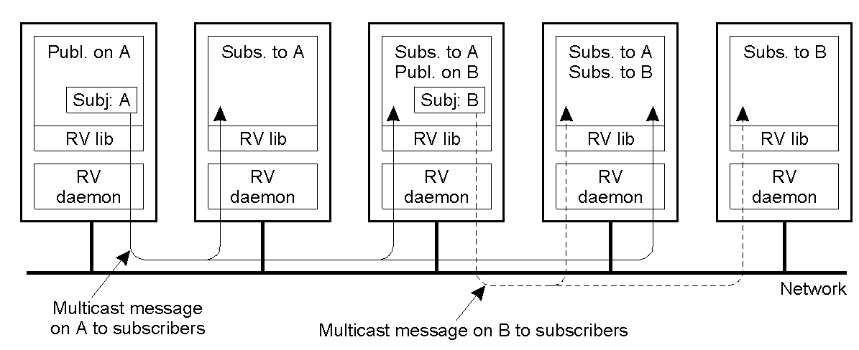
TIB/Rendezvous

Slide 12
TIB/Rendezvous
Architecture
Multicast protocol or P2P in available
Rendezvous Daemon only forwards messages subscribed to
Local (process, subject) table
Rendezvous router daemons allow the system to expand over large networks

Slide 13
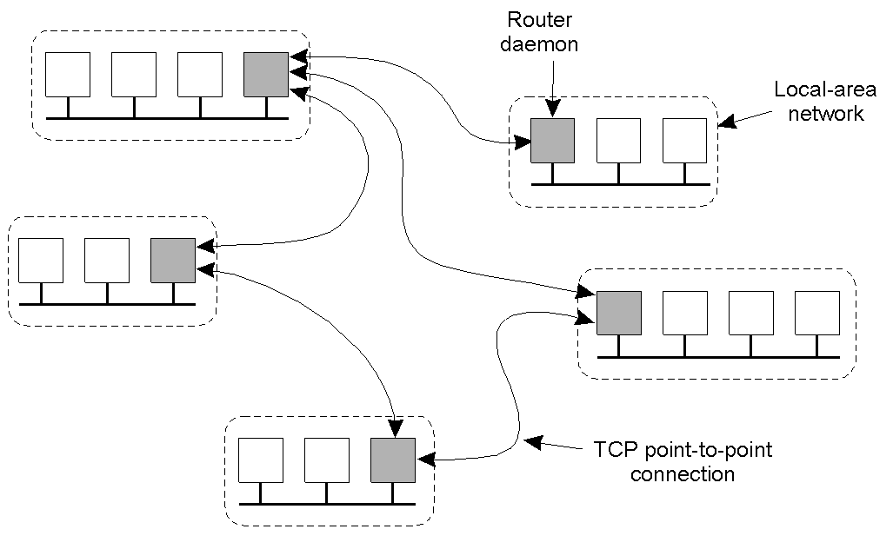
TIB/Rendezvous Routers

Slide 14
TIB/Rendezvous
Communication (1)
Self-describing message are sent consisting of:
  transports
  inbox name
  subject
  reply subject
  multiple fields

Slide 15
TIB/Rendezvous
Communication (2)
Transports
  Conceptually similar to Berkeley sockets allowing messages to be sent by broadcast, multicast or to specific ports
Inbox name
  Process specific name
  Used for P2P delivery
  Performance enhancement

Slide 16
TIB/Rendezvous
Communication (3)
Subject
  Sent as a character string
Reply subject
  Optional Reply subject
  Sender must still subscribe

Slide 17
TIB/Rendezvous
Communication (4)
Attribute | Type | Description
Name | String | The name of the field, possibly NULL
ID | Integer | A message-unique field identifier
Size | Integer | The total size of the field (in bytes)
Count | Integer | The number of elements in the case of an array
Type | Constant | A constant indicating the type of data
Data | Any type | The actual data stored in a field
Attributes of a TIB/Rendezvous Attribute Field

Slide 18
TIB/Rendezvous
Communication (5)
Communication Primitives
  send non-blocking
  sendreply non-blocking
  sendrequest blocking (uses inbox)

Slide 19
TIB/Rendezvous
Events (1)
Events are used to dispatch messages to subscribers (except for sendrequest responses)
A listener event is created
  Associated with the subject of interest and a transport
  Contains a reference to a callback function that is used to dispatch an event

Slide 20
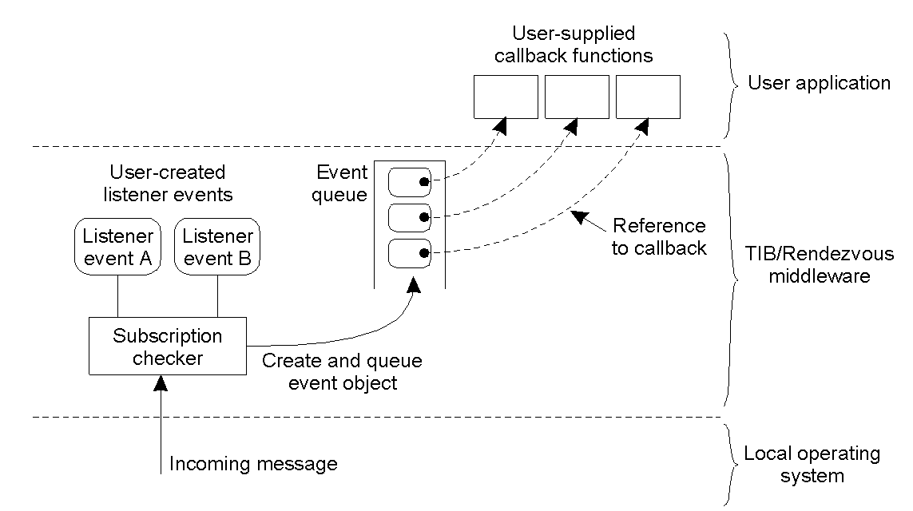
TIB/Rendezvous
Events (2)

Slide 21
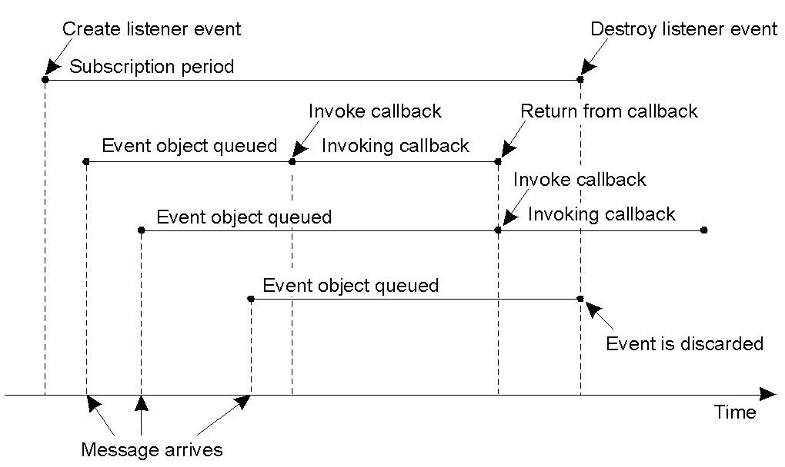
TIB/Rendezvous Events (3)

Slide 22
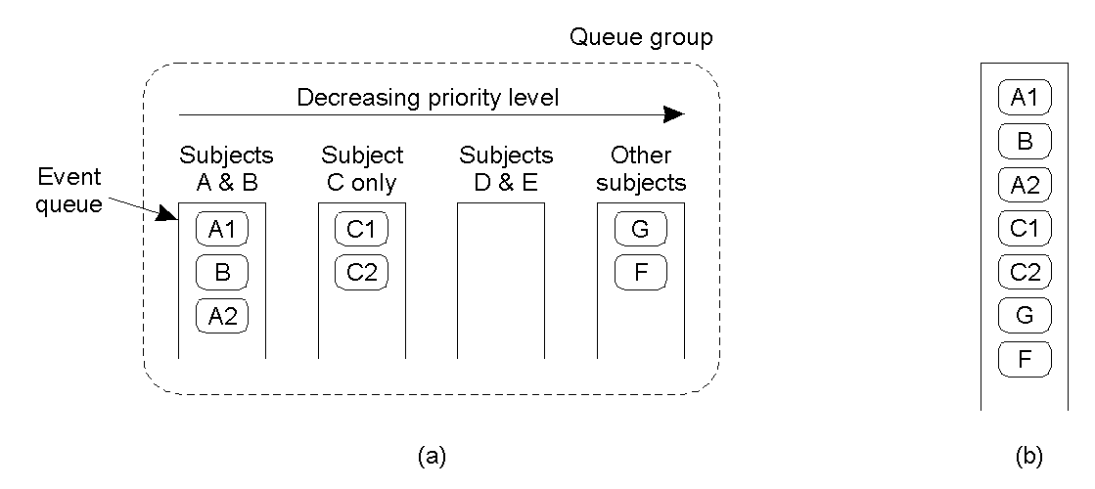
TIB/Rendezvous Queue Groups

Slide 23
TIB/Rendezvous Naming (1)
Example | Valid?
Books.Computer_systems.Distributed_Systems | Yes
.ftp.cuss.vu.nil | No (starts with a '.')
ftp.cuss.vu.nil | Yes
NEWS.res.com.so | Yes
Marten..van_Steen | No (empty label)
Marten.R.van_Steen | Yes

Slide 24
TIB/Rendezvous Naming (2)
Subject Name | Matches
*.cuss.vu.nil | ftp.cuss.vu.nil www.cuss.vu.nil
nl.vu.> | nl.vu.cuss.ftp nl.vu.cuss.zephyr nl.vu.few.www
NEWS.comp.*.books | NEWS.comp.so.books NEWS.comp.ai.books NEWS.comp.se.books NEWS.comp.theory.books

Slide 25
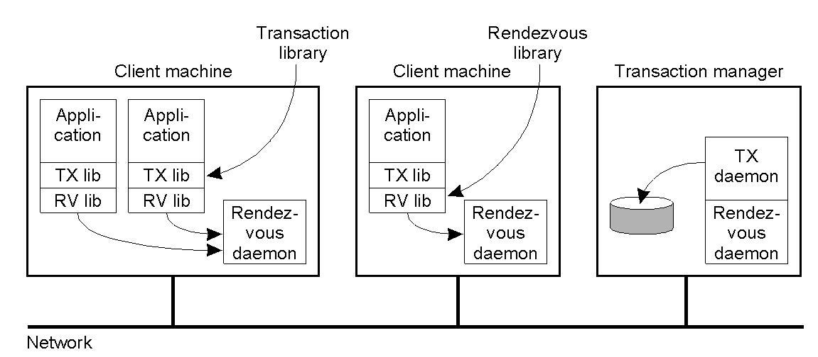
TIB/Rendezvous Transactions (1)

Slide 26
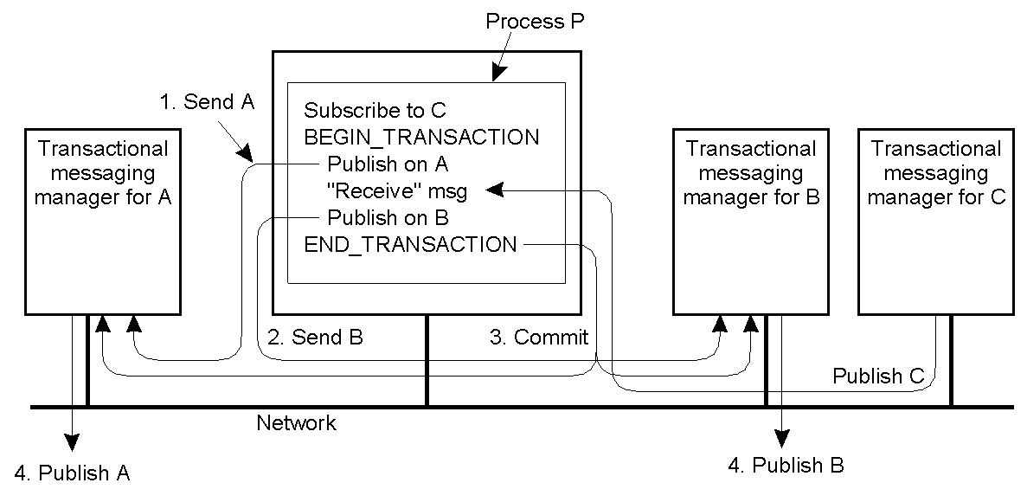
TIB/Rendezvous Transactions (2)

Slide 27
TIB/Rendezvous
Caching and Replication
Dealt with by application
Replicated processes cause problems (duplicated messages)
Cache server may cache the last n messages

Slide 28
TIB/Rendezvous
Fault Tolerance (1)
TIB/R assumes unreliable communication
Each message kept for 60 seconds
Sequence number attached to message and checked by daemons. WHY??
Message may still be lost
Pragmatic General Multicast

Slide 29
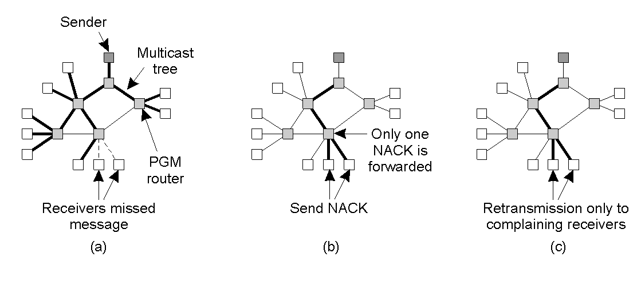
TIB/Rendezvous
Fault Tolerance (2)

Slide 30
JINI
JINI facilitates the provision and discovery of services especially those that provide simple non-complex services such as printing and activation of home appliances
Jini extends RMI
Jini services are plug and play – clients can discover services dynamically and transparently download the classes required to use those services.

Slide 31
JavaSpaces
A Jini service
Enables Java objects to communicate, share objects and coordinate tasks using an area of shared memory

Slide 32
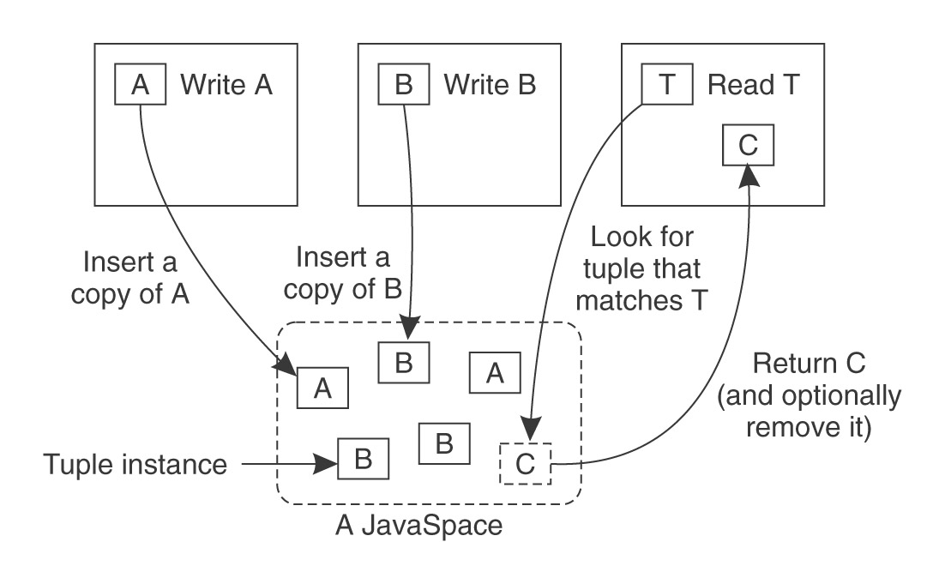
JavaSpaces

Slide 33
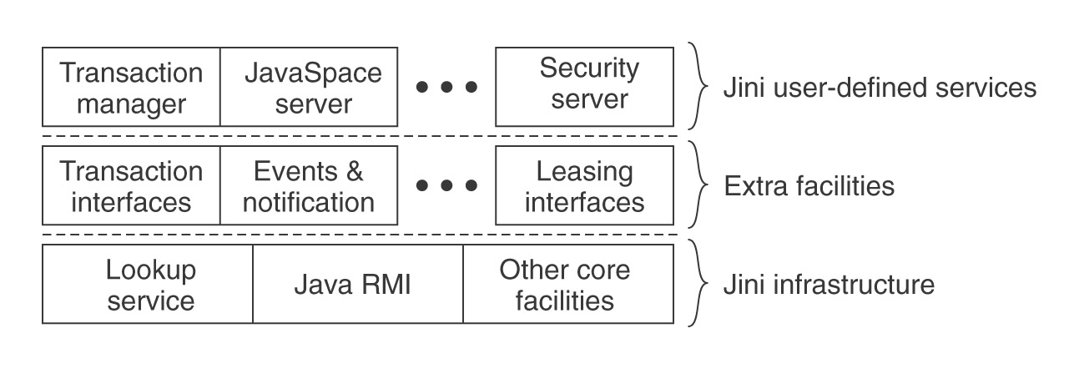
JavaSpaces

